Slide 1
A Guide to Creating Your 529 Account
DISCLAIMER: This guide was prepared by Agudath Israel of Maryland - which is not affiliated with the State of Maryland, Maryland 529, or T. Rowe Price, administrators of the Maryland 529 education savings plans. The content of this guide is solely the responsibility of the authors. The logos of Maryland 529 and T. Rowe Price and images from their webpages, are the property of the State of Maryland and/or T. Rowe Price. The views and opinions of the authors expressed on this webpage do not necessarily state or reflect those of the State of Maryland, Maryland 529, or T. Rowe Price with respect to any of the products or services they offer.

Slide 2
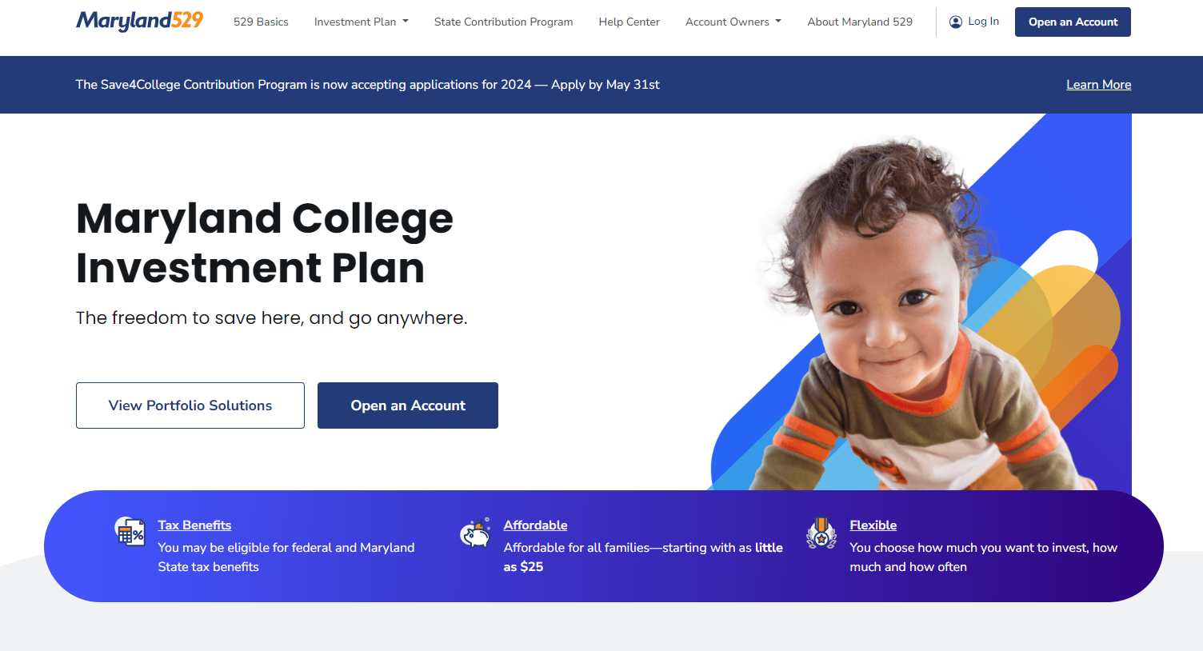
Log on to Maryland529.com to open your Maryland College Investment Plan

Slide 3
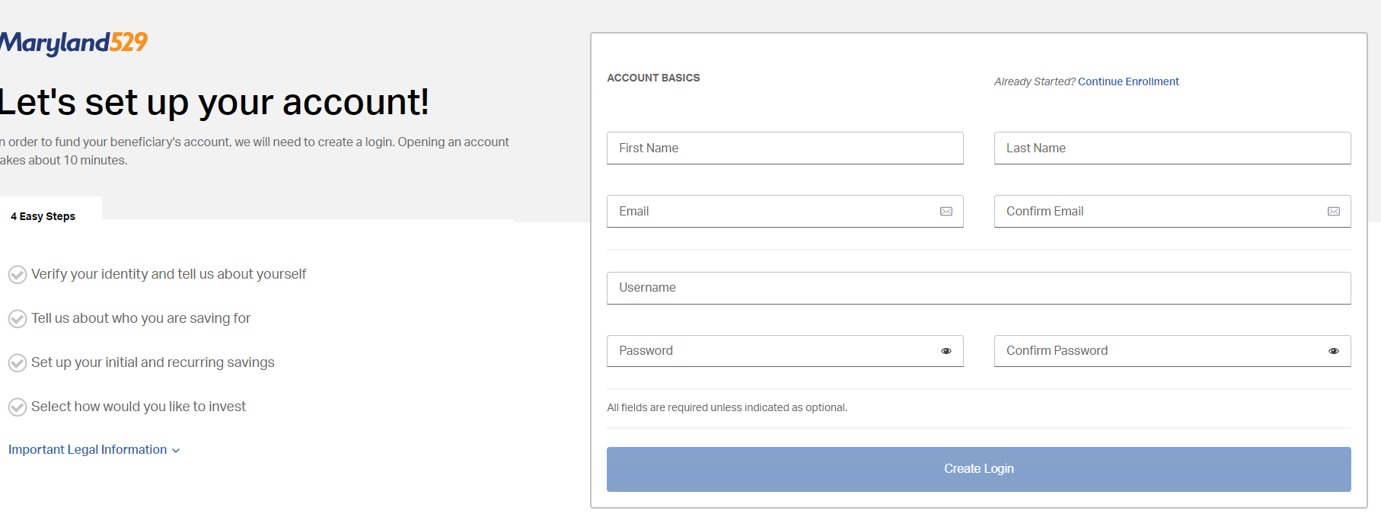
Follow the prompts to enter your information

Slide 4
Continue following the prompts to enter your personal information, the information of your child, and your account information

Slide 5
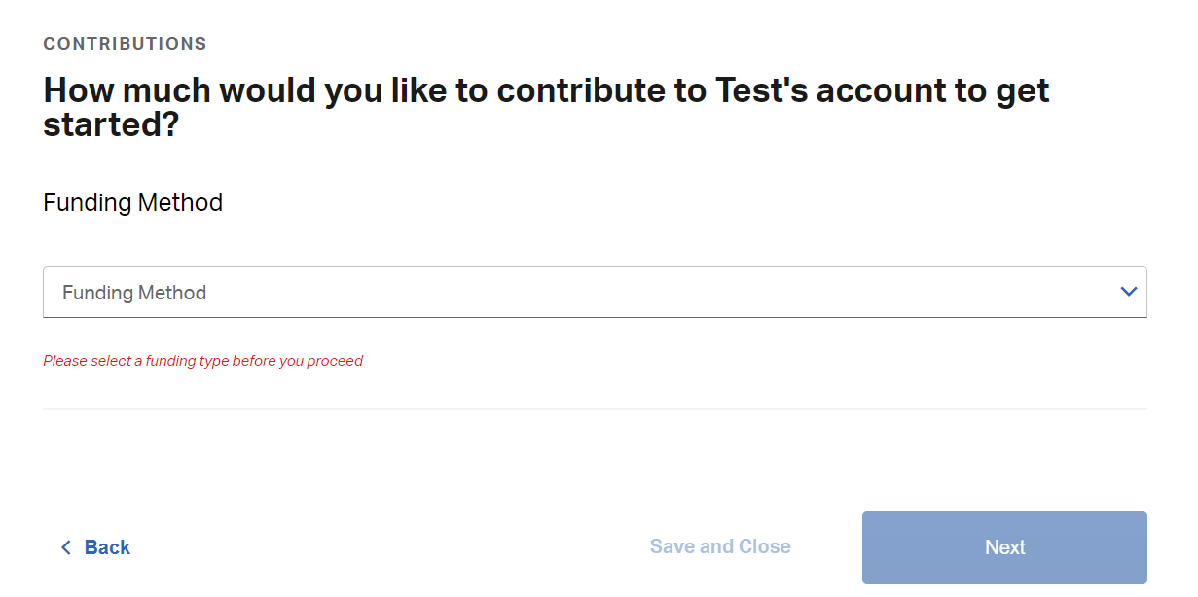
Choose a funding method for your account

Slide 6
You can choose to make a recurring contribution, or skip this step by clicking on the “Not right now” text (in blue)

Slide 7
This page allows you to choose how you want your “investment” account set up. This is most important if you are going to leave the money for 10-12 years until your child enters college, in which case you’d want maximum growth. If you are going to pull it out after 10 days to use for K-12 tuition, the “investment” piece means little, however you do need to choose a “portfolio.”

Slide 8
You will be offered a choice of fixed or enrollment based portfolios
Based on our research and on discussion with investment advisors and various individuals, we recommend choosing the “US Treasury Money Market Port” out of the fixed portfolios, as it has the least risk and is most reliable for short term needs. (It can be found by scrolling down to the bottom of the page.)

Slide 9
If you are not looking to diversify your account, allocate 100% to the Portfolio.

Slide 10
After reviewing the terms and conditions, and checking the necessary boxes, you can create your account.

